Slide 1
Oracle DB 프로젝트

Slide 2
c##reservation 유저 만들기 및 로그인 하기
sqlplus /nolog
SQL> conn sys as sysdba;
SQL> create user c##reservation identified by reservation;
SQL> grant connect,resource,dba to c##reservation;
SQL> conn c##reservation

Slide 3
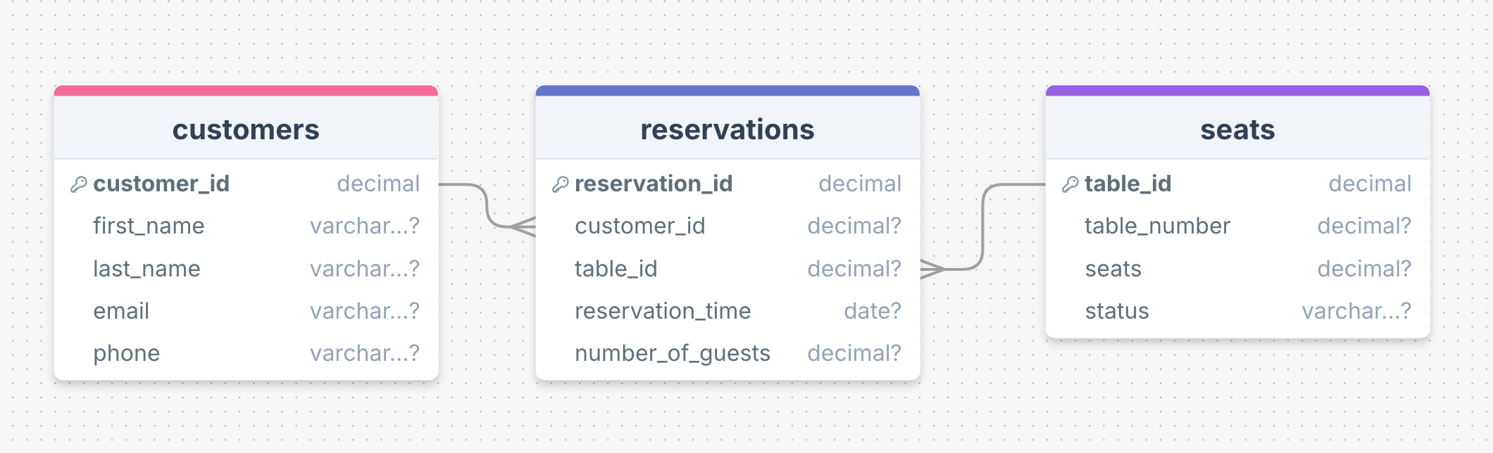
테이블 관계

Slide 4
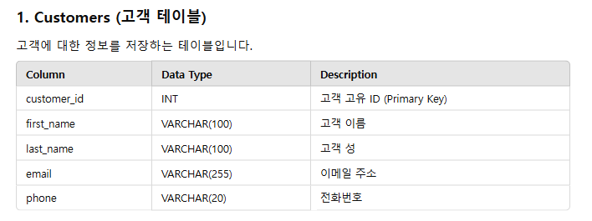

Slide 5
Customers 테이블 만들기
create table customers(
customer_id number primary key,
first_name varchar(100),
last_name varchar(100),
email varchar(255),
phone varchar(20)
);

Slide 6
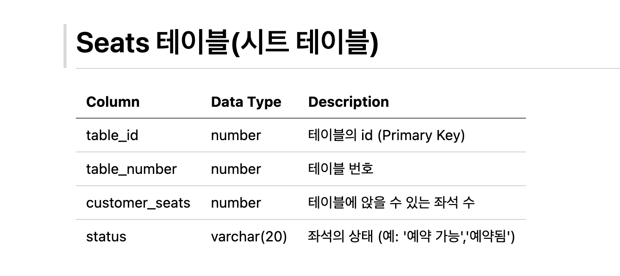

Slide 7
Seats 테이블 만들기
create table seats(
table_id number primary key,
customer_seats number,
status varchar(50)
);

Slide 8
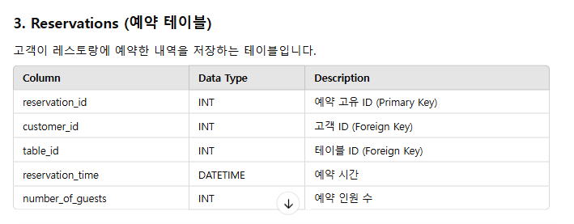

Slide 9
Reservations 테이블 만들기
create table reservations(
reservation_id number primary key,
customer_id number,
table_id number,
reservation_time date,
number_of_guests number,
foreign key (customer_id) references customers(customer_id),
foreign key (table_id) references seats(table_id)
);

Slide 10
Commit 하기
commit;

